Slide 1


Mobile Phone Security
Dr. Digvijaysinh Rathod
Associate Professor
(Cyber Security and Digital Forensics)
Institute of Forensic Science
Gujarat Forensic Sciences University
digvijay.rathod@gfsu.edu.in

Slide 2
Intent
Dr. Digvijaysinh Rathod

Slide 3


Reference
www.developer.google.com
https://data-flair.training/blogs/android-service-tutorial/
digvijay.rathod@gfsu.edu.in

Slide 4
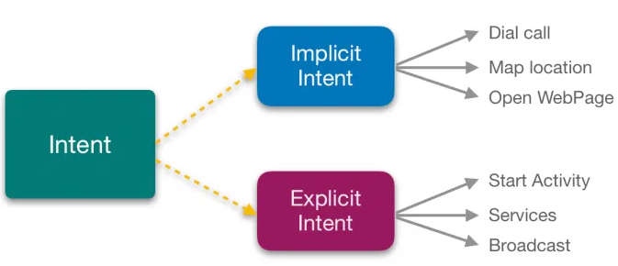
The application framework : Intent
There are two types of intents:
Explicit This intent satisfies the request within the application component. It takes the fully qualified class name of activities or services that we want to start.
Implicit Intent: This intent does not specify the component name. It invokes the component of another app to handle it.
Dr. Digvijaysinh Rathod

Slide 5
Intent
Intent – Communication object.
Intent Filter tells Android that which activity handle which action.
Whenever Android is given an Intent, It has to figure out which activity or activities can handles it.
This process is known as Intent Resolution.
Dr. Digvijaysinh Rathod

Slide 6
The application framework : Intent
There are two types of intents:
Explicit This intent satisfies the request within the application component. It takes the fully qualified class name of activities or services that we want to start.
Syntax
Starting the Activity
Intent intent = new Intent(getApplicationContext(), ActivityTwo.class);
startActivity(intent);
Dr. Digvijaysinh Rathod

Slide 7
The application framework : Intent
There are two types of intents:
Syntax
Starting the Service
Intent intent = new Intent(this, HelloService.class); startService(intent);
Syntax
Delivering Broadcast Receive
Intent intent = new Intent (“unique name”);
context.sendBroadcast(intent);
Dr. Digvijaysinh Rathod

Slide 8
The application framework : Intent
Implicit Intent: This intent does not specify the component name. It invokes the component of another app to handle it.
Syntax
Starting the Activity
Intent intent = new Intent();
intent.setAction=(Intent.ACTION_DIAL);
intent.setAction=(Intent.ACTION_VIEW);
intent.setAction=(Intent.ACTION_CALL);
Dr. Digvijaysinh Rathod

Slide 9
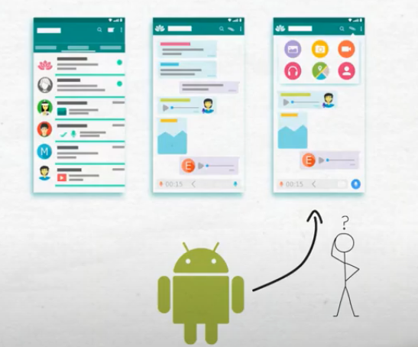
The application framework : Intent
Dr. Digvijaysinh Rathod

Slide 10
The application framework : Intent
Demonstration of two project (Intro_demo_android_master)
Explicit Intent
Implicit Intent
Ref: https://github.com/codepath/intro_android_demo
Dr. Digvijaysinh Rathod

Slide 11
Mobile Phone Security
Dr. Digvijaysinh Rathod
Associate Professor
(Cyber Security and Digital Forensics)
Institute of Forensic Science
Gujarat Forensic Sciences University
digvijay.rathod@gfsu.edu.in

Slide 12
Intent Component
&
Intent Filter
Dr. Digvijaysinh Rathod

Slide 13
The application framework : Intent
Intent intent = new Intent();
intent.setAction=(Intent.ACTION_DIAL);
intent.setAction=(Intent.ACTION_VIEW);
intent.setAction=(Intent.ACTION_CALL);
Dr. Digvijaysinh Rathod

Slide 14
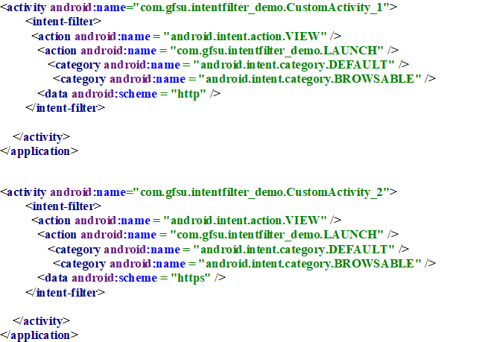



The application framework : Intent
Dr. Digvijaysinh Rathod

Slide 15
The application framework : Intent
Intent Filters
Basically, Intent Filters can define the behavior of Intents using three Elements, that are-
<actions> – Action name defines the intent action that it’ll accept.
<data> – Data defines the data that is acceptable.
<category> – Category defines the name of the Intent Category that is acceptable.
Dr. Digvijaysinh Rathod

Slide 16
The application framework : Intent
Intent Filters
You have seen how an Intent has been used to call an another activity.
Android OS uses filters to pinpoint the set of Activities, Services, and Broadcast receivers that can handle the Intent with help of specified set of action, categories, data scheme associated with an Intent.
You will use <intent-filter> element in the manifest file to list down actions, categories and data types associated with any activity, service, or broadcast receiver.
Dr. Digvijaysinh Rathod

Slide 17
The application framework : Intent
Intent Filters
Demo (IntentFilter_demo)
Dr. Digvijaysinh Rathod

Slide 18
The application framework : Intent
Any Intent object contains the following six things :
Component Name
Action
Data
Category
Extras
Flag
Dr. Digvijaysinh Rathod

Slide 19
The application framework : Intent
Any Intent object contains the following six things :
Component Name:
The intent object holds the name of the component of the Android application. Using component names, the system delivers an intent to a particular application component.
setComponent()
setClass()
setClassName()
Demo of the application (ImplicitIntentOne.apk)
Ref: https://www.codota.com/code/java/methods/android.content.Intent/setComponent
Dr. Digvijaysinh Rathod

Slide 20
The application framework : Intent
Any Intent object contains the following six things :
Action
Action defines the general task that is to be performed on components. Now, these actions directly target Activities, Services or Broadcast Receivers. Let’s see a few actions that an intent object stores:
Dr. Digvijaysinh Rathod

Slide 21
The application framework : Intent
Any Intent object contains the following six things :
Action
ACTION_VIEW content://contacts/people/1 -- Display information about the person whose identifier is "1".
ACTION_DIAL content://contacts/people/1 -- Display the phone dialer with the person filled in.
ACTION_DIAL tel:123 -- Display the phone dialer with the given number filled in.
Ref: https://developer.android.com/reference/android/content/Intent
Dr. Digvijaysinh Rathod

Slide 22
The application framework : Intent
Any Intent object contains the following six things :
Action
ACTION_VIEW tel:123 -- Display the phone dialer with the given number filled in. Note how the VIEW action does what is considered the most reasonable thing for a particular URI.
ACTION_EDIT content://contacts/people/1 -- Edit information about the person whose identifier is "1".
Dr. Digvijaysinh Rathod

Slide 23
The application framework : Intent
Any Intent object contains the following six things :
Action
ACTION_VIEW content://contacts/people/ -- Display a list of people, which the user can browse through. This example is a typical top-level entry into the Contacts application, showing you the list of people.
Dr. Digvijaysinh Rathod

Slide 24
The application framework : Intent
Any Intent object contains the following six things :
Category
This contains some additional information about what kind of object should hold the intent. An intent object can contain any number of type of categories.
This field is optional in an IntentObject.
Dr. Digvijaysinh Rathod

Slide 25
The application framework : Intent
Any Intent object contains the following six things :
Category : Some of the categories included are as follows :
BROWSABLE: The target components can be invoked in browsers to display data or message.
ALTERNATIVE: This means the component should be added in the list of alternative actions that the user performs on some data.
GADGET: This activity can be added inside some other components that host the gadgets.
Dr. Digvijaysinh Rathod

Slide 26
The application framework : Intent
Any Intent object contains the following six things :
Category : Some of the categories included are as follows :
HOME: This displays the home page of the user’s device.
LAUNCHER: The target can be an initial task and listed on the top of the application launcher.
Dr. Digvijaysinh Rathod

Slide 27
Mobile Phone Security
Dr. Digvijaysinh Rathod
Associate Professor
(Cyber Security and Digital Forensics)
Institute of Forensic Science
Gujarat Forensic Sciences University
digvijay.rathod@gfsu.edu.in

